Slide 1
.
AI-DRIVEN CUSTOMIZED CYBER SECURITY TRAINING AND AWARENESS
Presented by:
BATCH-C2
PROJECT TEAM:
-SUCHITHRA BEJUGAM (21D31A6203)
-PRANAVI CHAKILAM (21D31A6205)
-VASANTH MANKALA (21D31A6212)
Guided by:
Mr. M A. Taqui
(Assistant professor)

Slide 2
Objective
Ensure integrity verification of NIST test files.
Enable cryptographic analysis of uploaded files.
Generate secure, systematic reports based on user input.
To demonstrate how AI can simplify the understanding of complex cybersecurity controls

Slide 3
Introduction
In today’s digital world, cyber threats are increasing in both complexity and frequency.
Traditional cybersecurity training often lacks the adaptability to keep up with evolving threats.
This creates a gap in awareness, understanding, and preparedness among both cybersecurity professionals and general employees.
There is a growing demand for more intelligent and personalized training solutions that evolve alongside the threat landscape.

Slide 4
Introduction
Cybersecurity requires integrity and secure data analysis.
NIST files are essential in cryptographic verification.
This system allows users to upload, analyze, and review cryptographic properties of NIST files.

Slide 5
Existing System
Manual NIST file verification.
Limited support for integrity and crypto checks.
Lack of user-friendly interfaces and automation.

Slide 6
Disadvantages of Existing System
Inability to Adapt
Lack of automated report generation.
No centralized system for file upload and analysis.
Generic Training Modules

Slide 7
Proposed System
AI-Driven Customized Cybersecurity Training And Policies
Tailors training to employee roles, knowledge, and learning styles using AI
Provides instant feedback to reinforce understanding and identify weaknesses

Slide 8
Proposed System
Continuously updates with the latest cybersecurity threats and trends
Builds a culture of cybersecurity awareness, enabling proactive threat defense
Uses AI to tailor learning paths based on each employee’s role, knowledge, and preferences

Slide 9
Advantages of Proposed System
Faster and automated file processing.
Personalized Learning Paths
Increased Engagement
Improved accuracy of cryptographic analysis.
Comprehensive and structured reports.

Slide 10
Software Requirements
Operating System: Windows/Linux
Language: Python, JavaScript
Database: MySQL
Web Framework: Django
Browser: Chrome/Firefox

Slide 11
Hardware Requirements
Processor: Intel i5 or above
RAM: Minimum 4 GB
Hard Disk: 100 GB or more
Internet Connection

Slide 12
Modules
User Module
Admin Module
Cybersecurity Training and Awareness Module

Slide 13
UML Diagrams
1. Use Case Diagram
2. Data Flow Diagram (DFD)
3. Class/Sequence Diagram

Slide 14
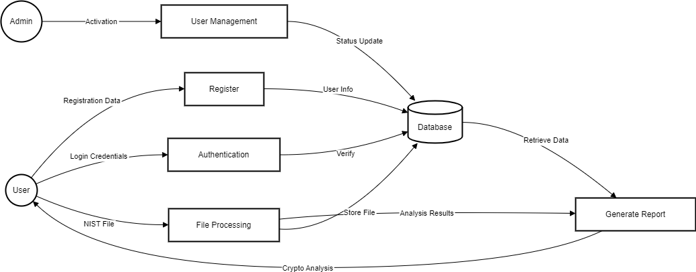
Data Flow Diagram (DFD)

Slide 15
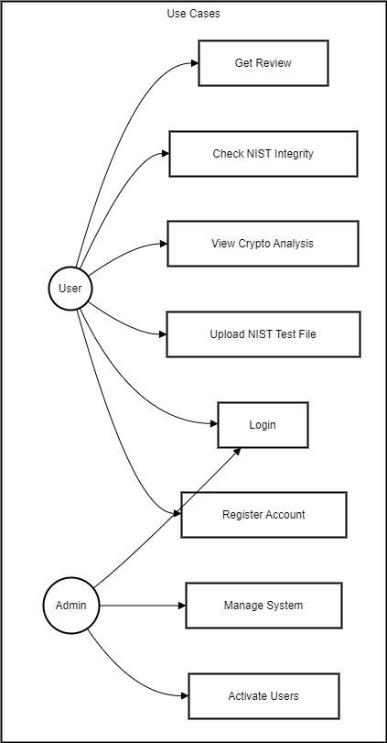
Use case diagram

Slide 16
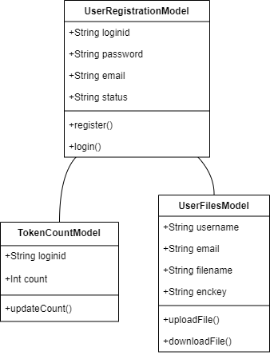
Class Diagram

Slide 17
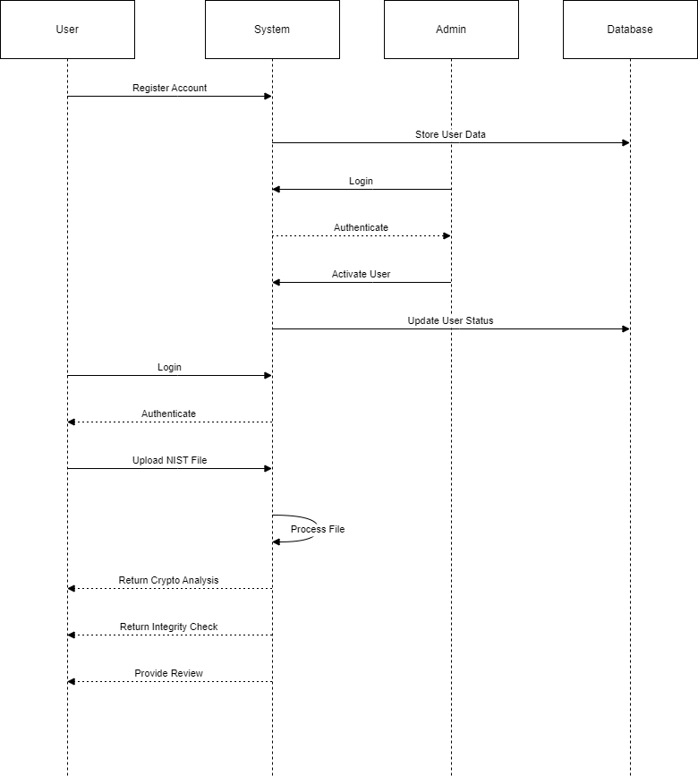
Sequence Diagram

Slide 18
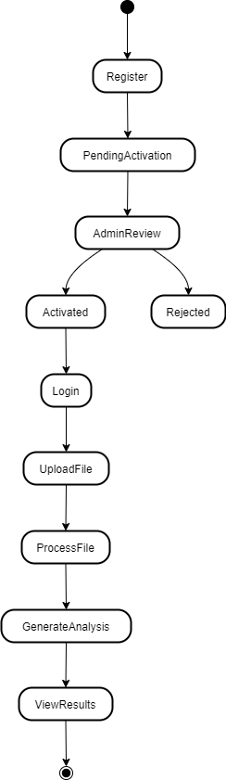
Activity Diagram

Slide 19
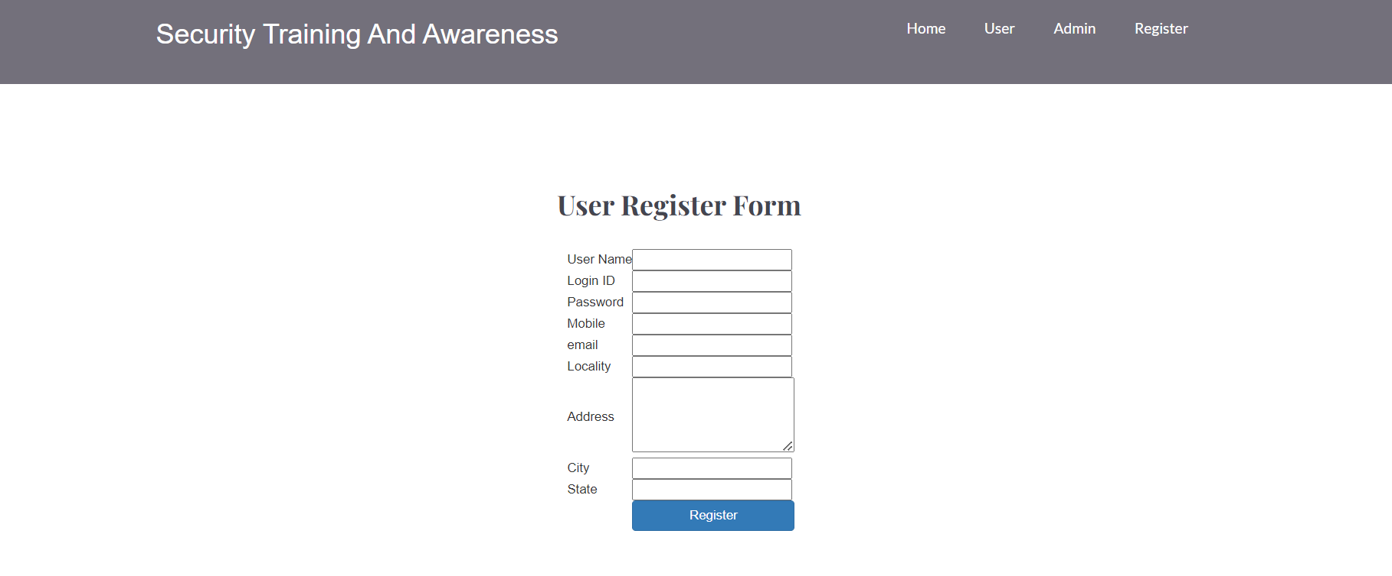
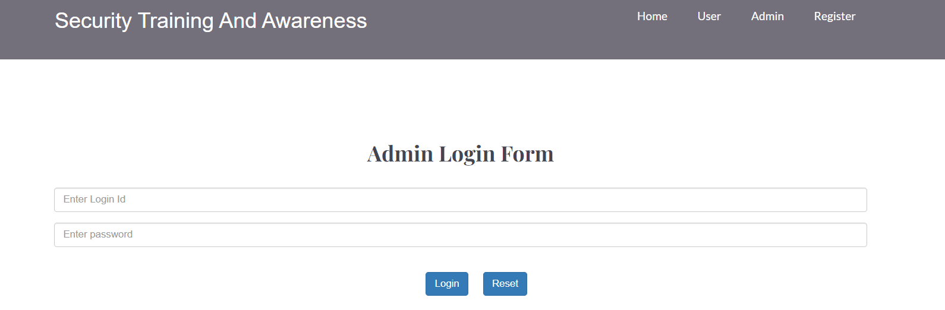
Results
User registration Form
User admin form

Slide 20
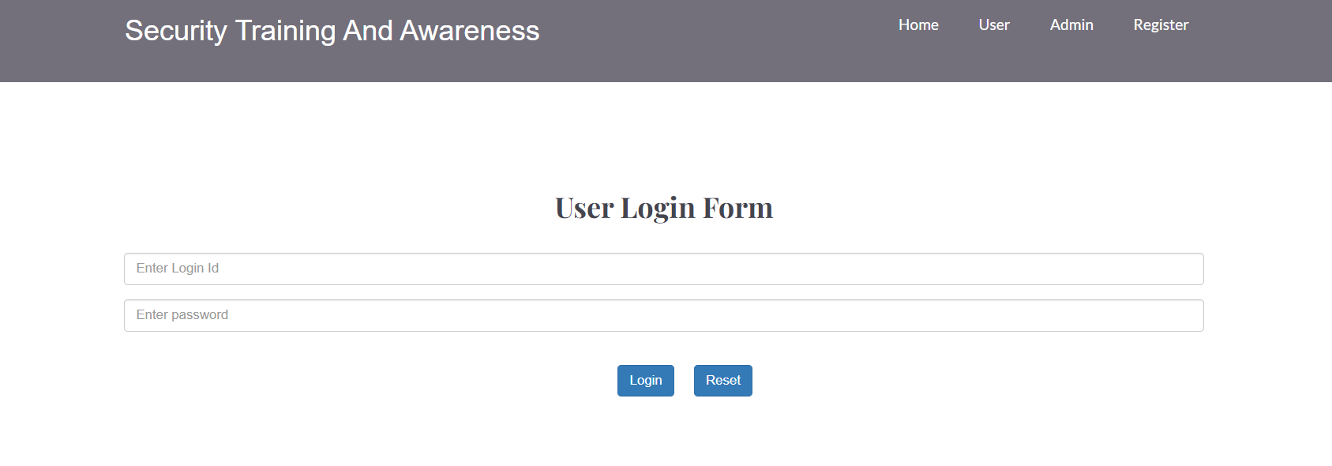
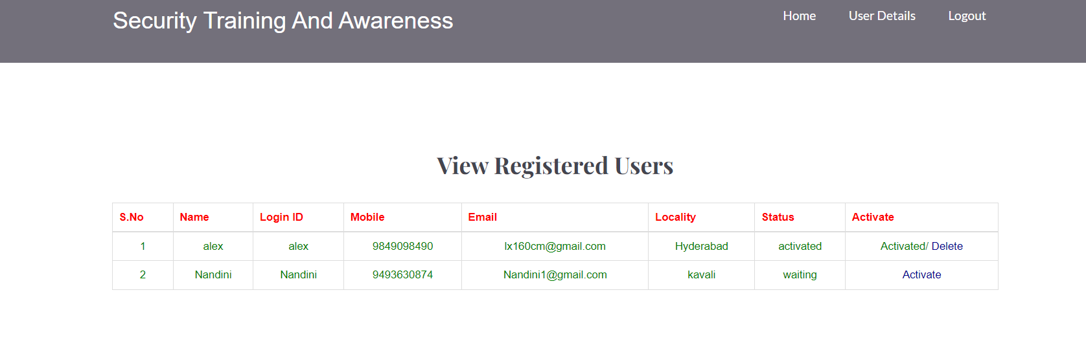
Results
User login Form
User Details Form

Slide 21
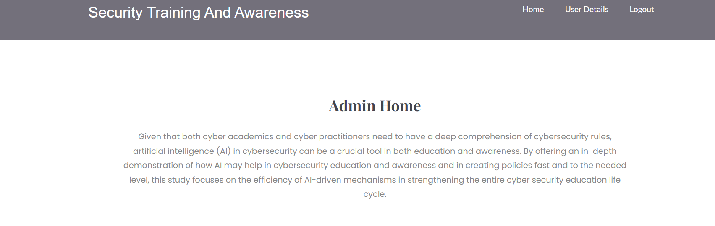
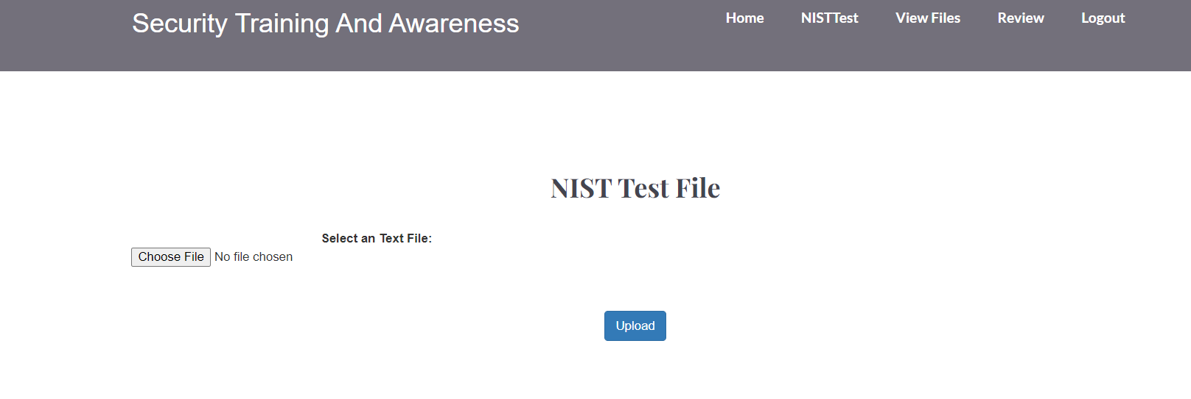
Results
Admin home page
File upload page

Slide 22
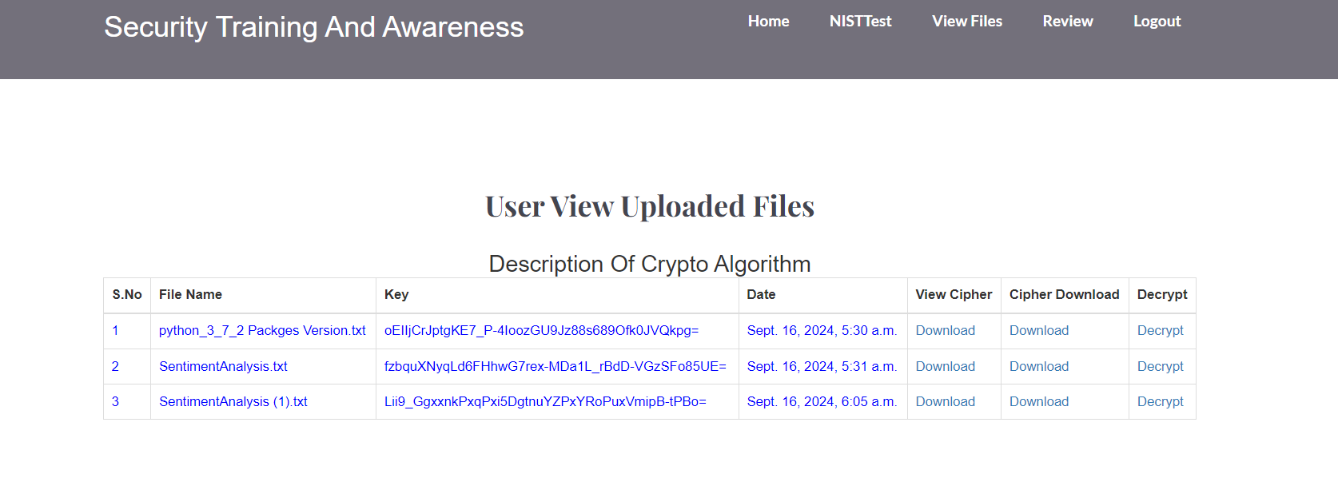
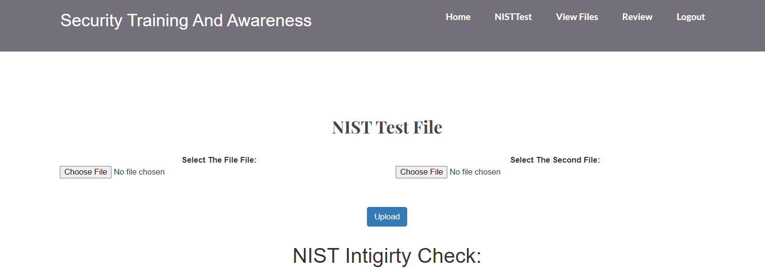
Results
User view page
Review page

Slide 23
System Testing
Test Case ID | Test Description | Input Details | Expected Outcome | Status
TC-001 | User Registration - Valid Data | Username: validUser Email: user@example.com Password: StrongPass123! | Registration successful; user status set to "pending" | Pass
TC-002 | User Registration - Invalid Email Format | Username: validUser Email: user@.com Password: StrongPass123! | Registration failed; display error message for invalid email | Pass
TC-003 | User Registration - Password Too Weak | Username: validUser Email: user@example.com Password: pass | Registration failed; display error message for weak password | Pass
TC-004 | User Registration - Missing Required Fields | Username: <empty> Email: user@example.com Password: StrongPass123! | Registration failed; display error message for required fields | Pass
TC-005 | Admin Activation - Activate Pending User | Username: validUser | User status updated to "active"; notification sent to user | Pass
TC-006 | Admin Activation - Reject Pending User | Username: validUser | User status marked as "rejected"; notification sent to user | Pass
TC-007 | User Login - Valid Credentials | Username: validUser Password: StrongPass123! | Login successful; redirect to training dashboard | Pass
TC-008 | User Login - Invalid Password | Username: validUser Password: WrongPass123! | Login failed; display error message for incorrect credentials | Pass
TC-009 | User Login - Inactive User | Username: inactiveUser Password: StrongPass123! | Login failed; display error message indicating user is inactive | Pass
TC-010 | Training Access - Click Training Button | After successful login | Training module loads successfully | Pass
TC-011 | Training Completion - Accuracy Score Display | Complete training session | Display accuracy score on completion page | Pass
TC-012 | Prediction Based on Training Input | User input from training session | Display prediction based on the accuracy score and input data | Pass

Slide 24
Conclusion
Project ensures reliable cryptographic verification.
User-friendly interface and automated testing enhance cybersecurity.
Scalable for integration with future tools.

Slide 25
Future Enhancements
Real-Time Phishing Simulations
Community Building and Peer Learning
Gamification:
Implement multi-language support and mobile compatibility.

Slide 26
References
NIST Official Website
Cryptographic Algorithms Documentation
IEEE and Springer papers on Crypto Analysis

Slide 27


